Slide 2

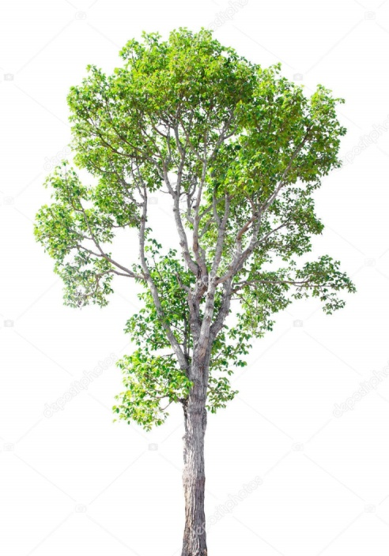
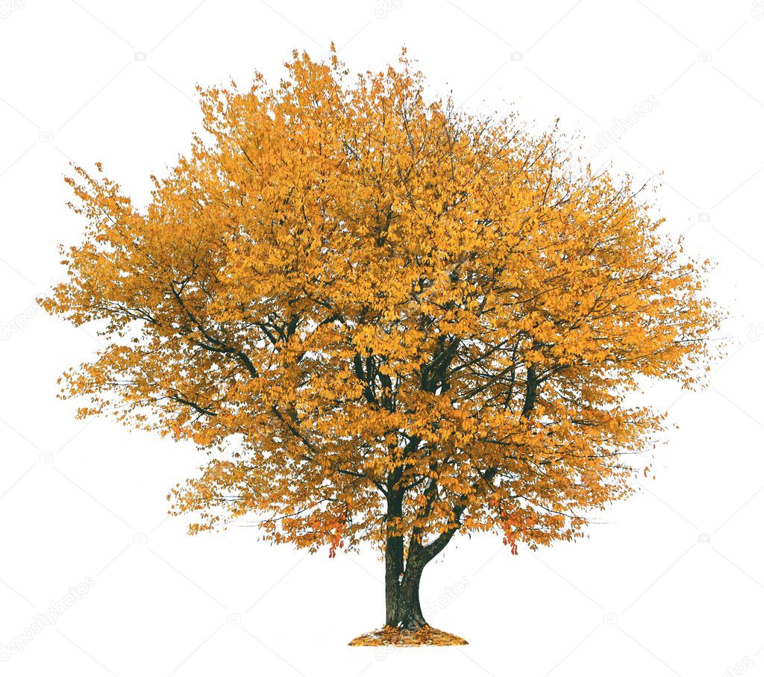


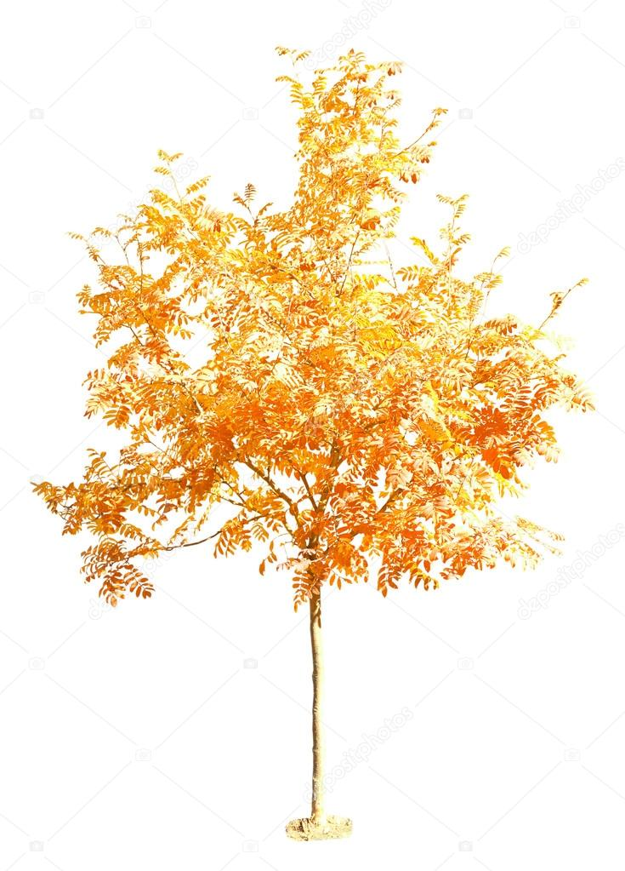
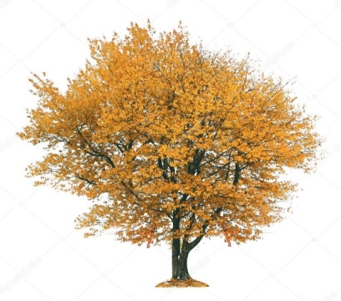
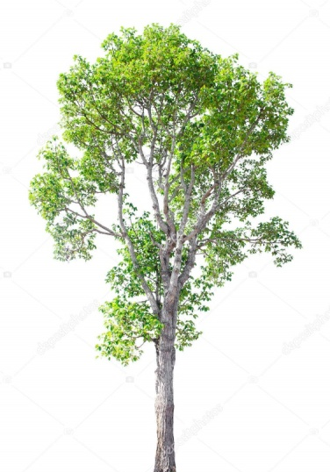

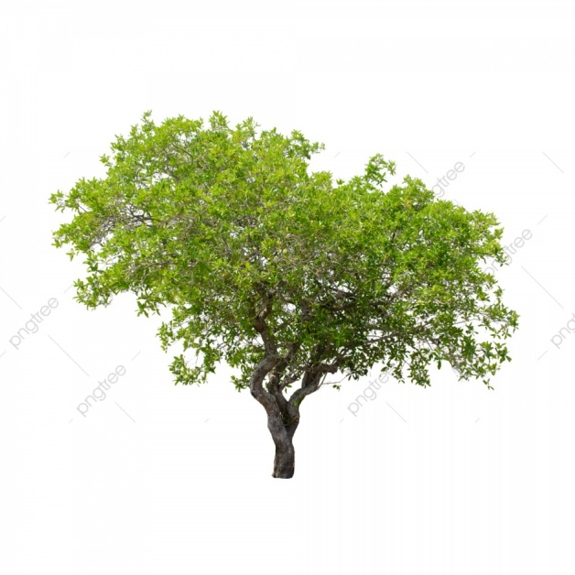



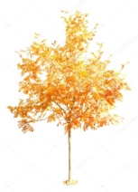


Slide 3
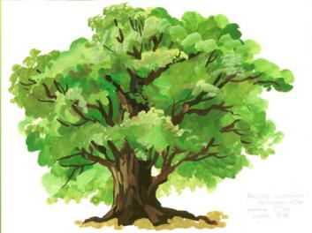

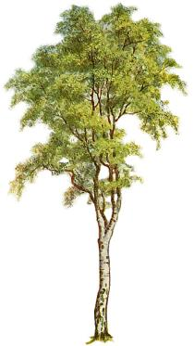
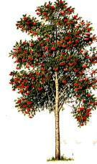
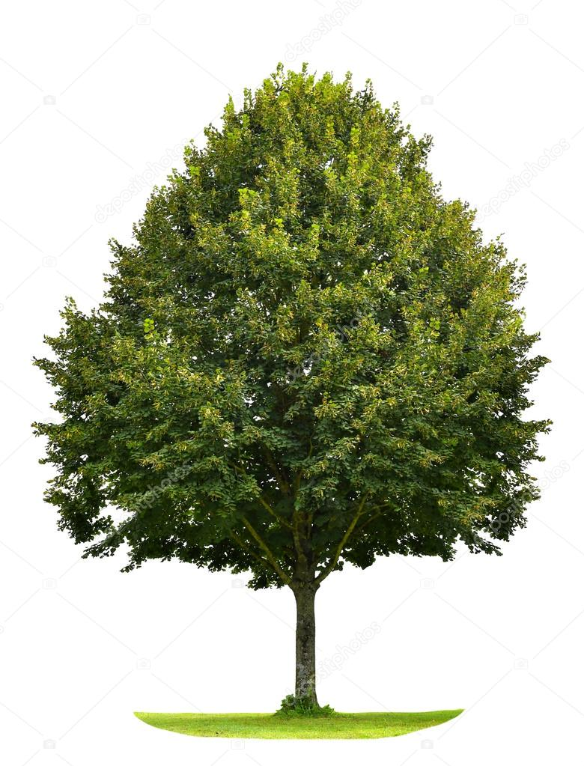
дуб
рябина
липа
берёза
клён

Slide 4




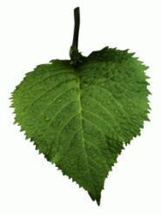
Листья
дуба
клёна
липы
берёзы
рябины

Slide 5
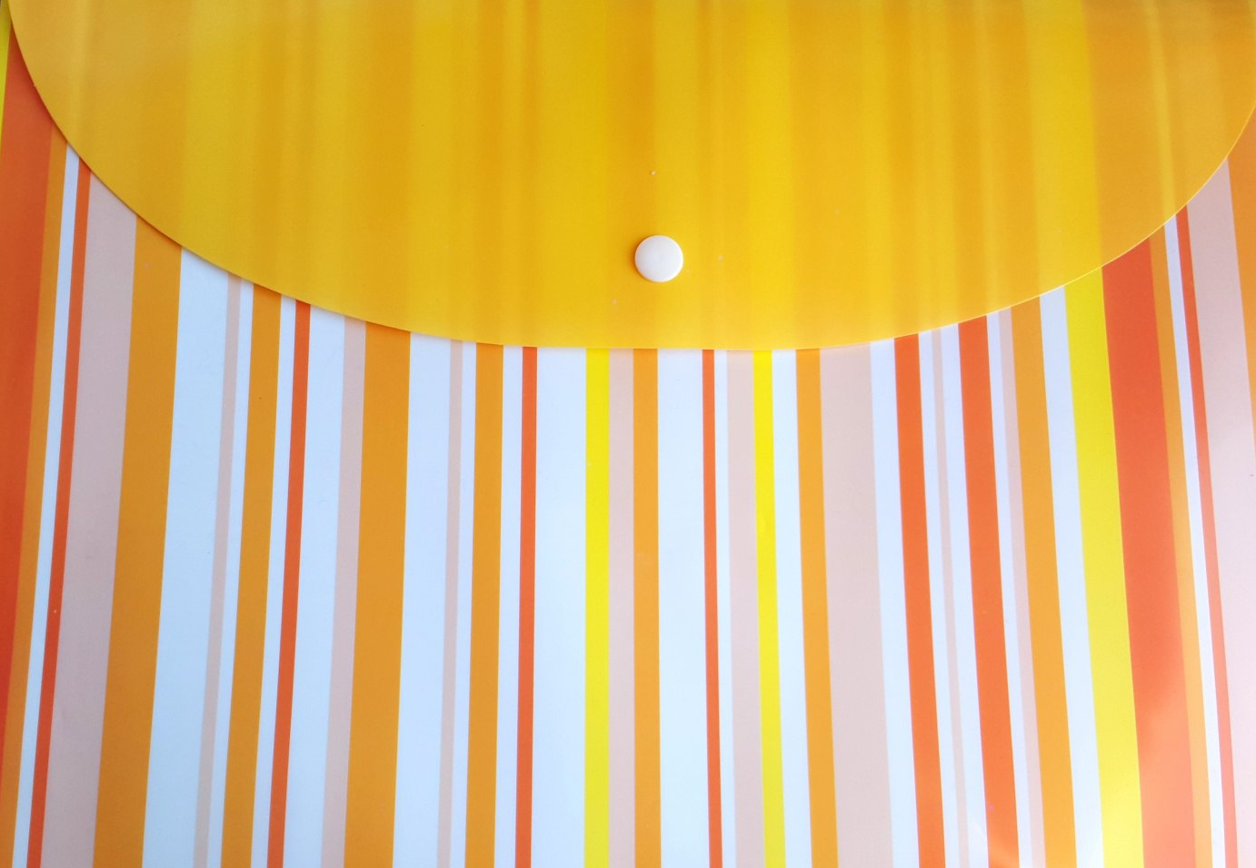
Кейс
(папка)

Slide 6
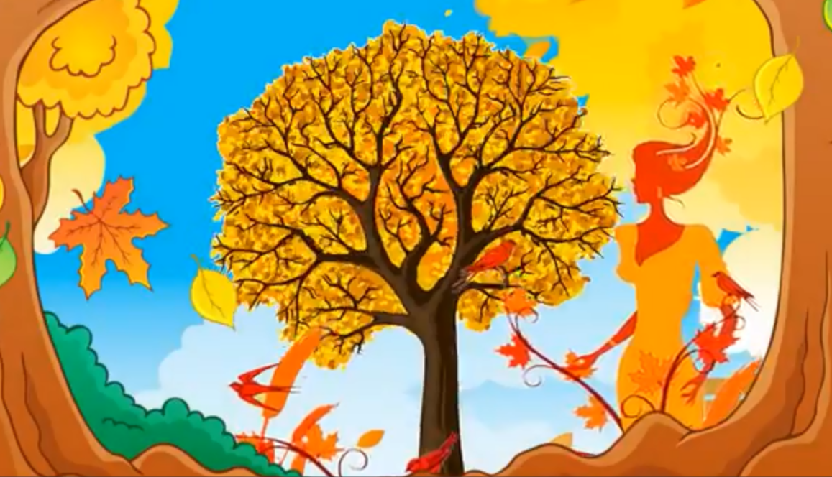
Весёлый танец

Slide 7
https://www.google.com/url?sa=i&source=images&cd=&cad=rja&uact=8&ved=2ahUKEwjeh7eox4rlAhWj16YKHeWwCy8QjRx6BAgBEAQ&url=%2Furl%3Fsa%3Di%26source%3Dimages%26cd%3D%26ved%3D%26url%3Dhttps%253A%252F%252Fru.depositphotos.com%252F123559160%252Fstock-illustration-cartoon-funny-red-car.html%26psig%3DAOvVaw13sxQNTpFh7vraBiy3t_07%26ust%3D1570550468482455&psig=AOvVaw13sxQNTpFh7vraBiy3t_07&ust=1570550468482455 - машинка
https://www.google.com/url?sa=i&source=images&cd=&ved=2ahUKEwiW9sfLxIrlAhVrw8QBHeupCEIQjRx6BAgBEAQ&url=https%3A%2F%2Fru.depositphotos.com%2F149583166%2Fstock-photo-isolated-trees-on-white-background.html&psig=AOvVaw0AcLWn-jtYgGYVtQ7j7yzY&ust=1570551013361988- березка
https://www.google.com/url?sa=i&source=images&cd=&cad=rja&uact=8&ved=2ahUKEwj9rLaMxYrlAhUJwqYKHSVsBCIQjRx6BAgBEAQ&url=https%3A%2F%2Fru.pngtree.com%2Ffreepng%2Fisolated-trees-on-white-background._3762654.html&psig=AOvVaw0AcLWn-jtYgGYVtQ7j7yzY&ust=1570551013361988-дерево
https://www.google.com/url?sa=i&source=images&cd=&ved=2ahUKEwjoxo60y4rlAhUN4KYKHWCaDVQQjRx6BAgBEAQ&url=https%3A%2F%2Fru.depositphotos.com%2F103081176%2Fstock-photo-autumnal-tree-isolated-white.html&psig=AOvVaw0hAXI64-2LnGYAP-F0C7j3&ust=1570552793086558- осеннее дерево
https://www.google.com/url?sa=i&source=images&cd=&ved=2ahUKEwi08_nsy4rlAhWrysQBHUJQB_0QjRx6BAgBEAQ&url=https%3A%2F%2Fru.depositphotos.com%2F91869572%2Fstock-photo-beautiful-autumnal-tree.html&psig=AOvVaw0hAXI64-2LnGYAP-F0C7j3&ust=1570552793086558- рябина
https://www.google.com/url?sa=i&source=images&cd=&cad=rja&uact=8&ved=2ahUKEwilrrvB3IrlAhWh2aYKHSCyD-EQjRx6BAgBEAQ&url=https%3A%2F%2Fru.depositphotos.com%2F83641368%2Fstock-photo-green-linden-tree-isolated-on.html&psig=AOvVaw1me5fSm-gFccDJRg4z7bpb&ust=1570557269750051- липа
https://www.google.com/url?sa=i&source=images&cd=&cad=rja&uact=8&ved=2ahUKEwjl3LzT3YrlAhU7wcQBHbACCNIQjRx6BAgBEAQ&url=https%3A%2F%2Fru.depositphotos.com%2F27249043%2Fstock-photo-linden-leaf-isolated-on-white.html&psig=AOvVaw25GUav_mmDe_tqc5tlZgnV&ust=1570557669325780- лист липы

