Slide 1
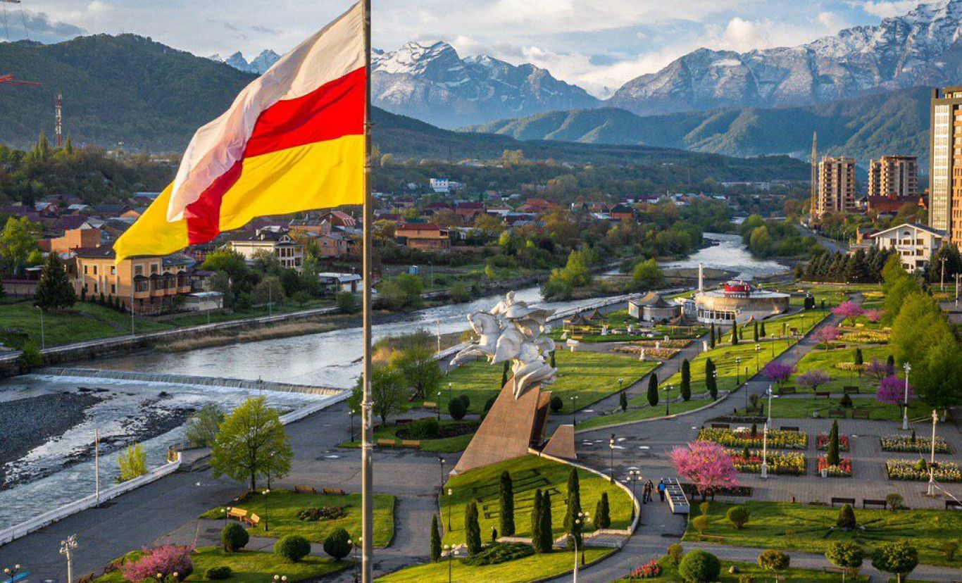
Municipal budgetary educational institution of the city of Alagir school №2.
Individual project
Guests, sent from above
Completed by: the 11 th form student Alina Kozaeva
Project manager:: English Teacher
Irene Hadzhumarovna Cheldieva

Slide 2
THE INTRODUCTION
Tourism- a journey for pleasure or business, as well as the theory and practice of tourism, the business of attracting, accommodating and entertaining tourists and the business of organizing tours.
Actuality: the topic of tourism is very relevant in the modern world because it contributes to the development of the economy, the creation of new jobs and the improvement of the standard of living of the population.
The object of the study: the republic of North Ossetia-Alania.
The aims:
1. to find out the history of the origin of tourism
2. to analyze the prospects for the development of tourism in North Ossetia
3. to identify the places most frequently visited by tourists in Ossetia.
Tasks: 1. to study historical monuments, geographical objects of North Ossetia;
2. to plan, choose, evaluate ways of activity to solve problems related to the organization and conduct of hiking trips;
3. to analyze the mistakes made in the course of practical activity;
4. to contribute to the formation of a common culture among students, through familiarization with tourist and local history activities
Research methods:
1.observation
2. photographing
3. comparison

Slide 3
THE CONCEPT OF TOURISM
Tourism- a social, cultural and economic phenomenon which entails the movement of people to countries or places outside their usual environment for personal or business/professional purposes.
People who travel are called visitors (which may be either tourists or excursionists; residents or non-residents) and tourism has to do with their activities, some of which involve tourism expenditure.
Types of tourism are distinguished according to the target function, motives and results of tourism:
• sports
• recreational
• rehabilitation
• professional
• educational
• cultural
• entertainment
• excursion
• local history
• expedition
• business
• commercial
• combined

Slide 4
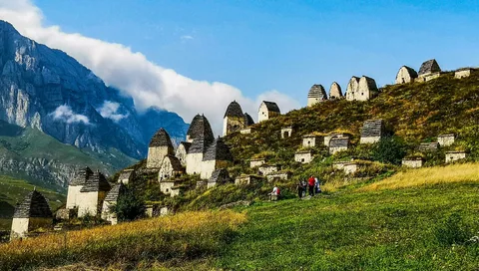
The history and development of tourism in Ossetia

Slide 5
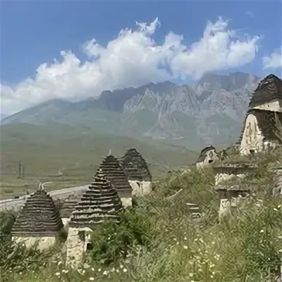
Travelling, respectively, and tourism have played an important role in the formation and development of world civilization. This process also affected the Caucasus. K.L.Khetagurov was the first who drew attention to the issues of travel and excursions conducted in the North Caucasus. Not being a specialist in the field of tourism, never engaged in organizing sightseeing activities, he noted the importance of recreation for the educational process, focusing on natural and social-ethnographic objects. After the establishment of Soviet power, the development of tourism and mountaineering became one of the main tasks of the Soviet trade unions. Considerable attention was paid to it in newspapers, magazines, news guidebooks were published, which took into account the already existing experience of pre-revolutionary authors, but the tourist and recreational activity itself had an ideological orientation.

Slide 6
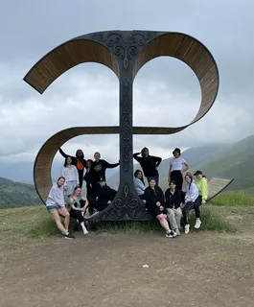
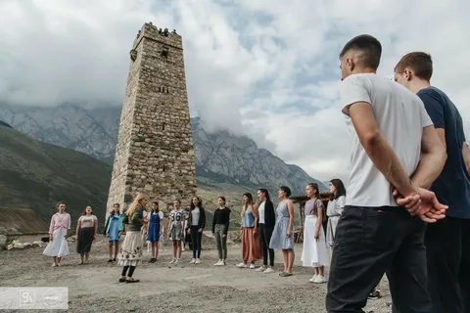
TOURISM IN OSSETIA NOW

Slide 7
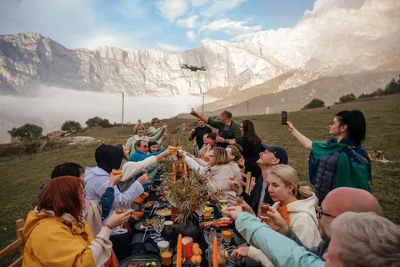
One can’t call North Ossetia a popular tourist destination because tourism in our republic is not on the level it should be. We are a republic with a unique nature. The republic is an important object to develop tourism. Residents of the region also show interest in the sights of Ossetia, because many of them are in involved in its industry. Tourism has great potential thanks to the untouched corners of nature, combining the historical monuments of Vladikavkaz and the North Ossetia-Alania in the whole. Tourism is a journey for pleasure or on business accommodation and tourists entertaining as well as organized tours.

Slide 8
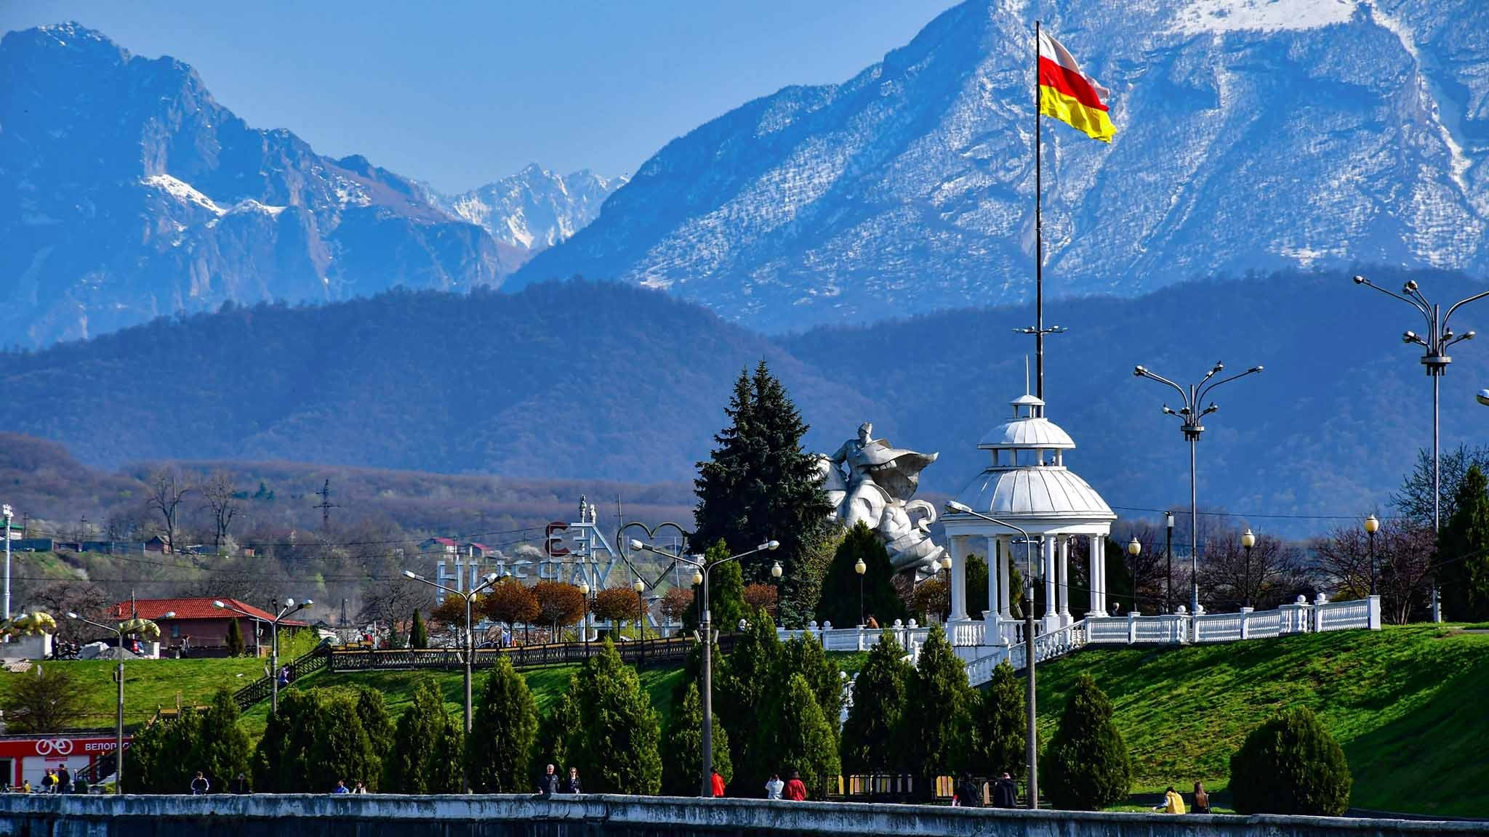
Places most visited by tourists in Ossetia.

Slide 9
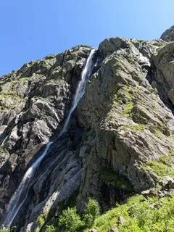
Midagrabinskie waterfalls
They are considered to be the highest in Europe .The largest of them is the Big Zeigalan. The height of the continuous fall of water is 750 meters. According to the legend, if you stand next to it you can make a wish which must certainly come from the heart, this concentrated energy of water will quickly lift your goal into the universe. Knowledgeable people say that all your wishes and dreams may come true if you are open-hearted persons.

Slide 10
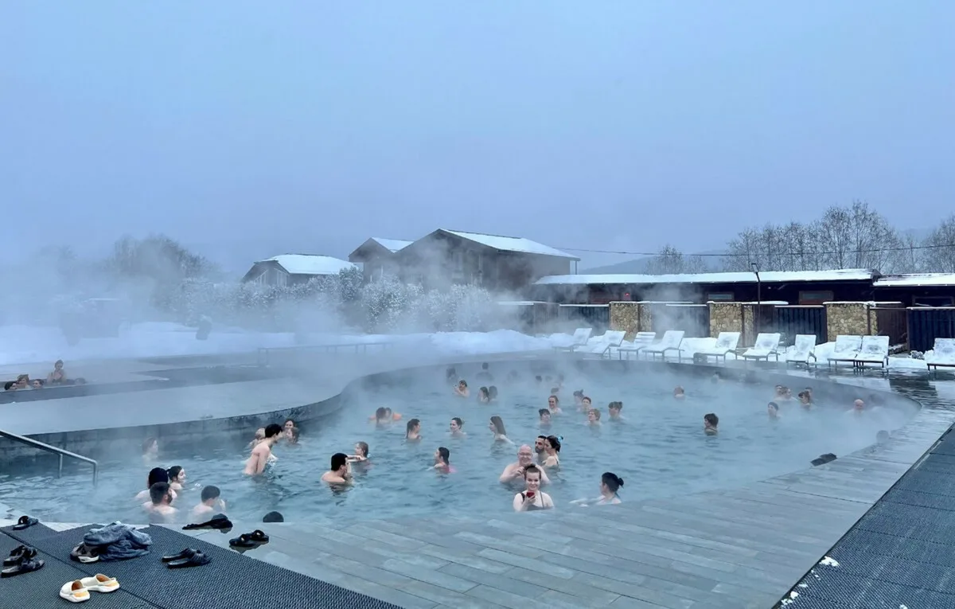
The Biragzansky thermal springs are a natural phenomenon in the mountains of North Ossetia, known for their healing properties. The springs are located in the village of Verkhny Biragzang, near Vladikavkaz. In the 1990s, oil exploration activities were conducted in the area where the thermal baths are located, but during the drilling process, a mineral spring with hot water emerged instead of black gold. Later, the healing properties of this water were discovered, attracting visitors from neighboring regions.
Biragzansky Thermal Springs

Slide 11
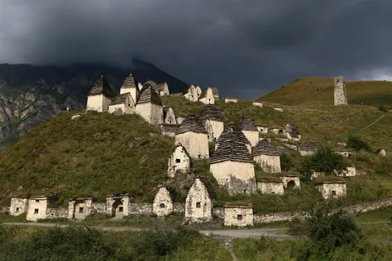
"City of the Dead" Dargavs
A vacation to North Ossetia will be incomplete if you do not visit Dargavs — the business card of the republic and its best view from a postcard. The Ossetian city of the dead is under the patronage of UNESCO, but, to be honest, its best protection is its sacred history. The locals never visit this sacred placeas not to disturb the souls of the dead and do not come close after sunset. They have not been buried in Dargavs since the 30s of the 19th century, when the process of resettlement of mountaineers to the plain began. During the epidemic, in order not to infect other populations, the sick people voluntarily went there, built crypts. Now it is more a place of tourist pilgrimage.

Slide 12
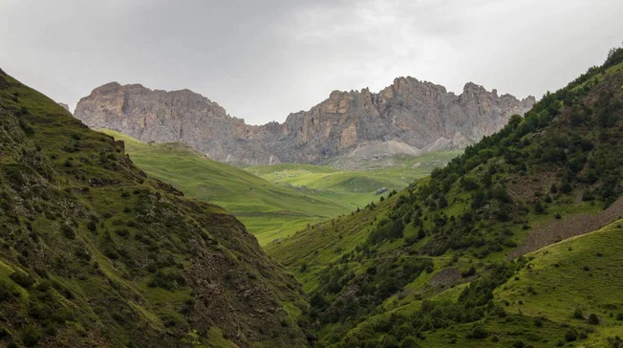
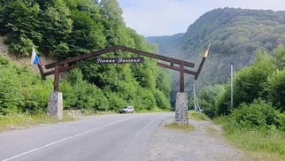
Digoria
Two districts in the western part of the republic — Irafsky and Digorsky — are united by the name of Digoria and we called it the national Park "Alania". This is one of the youngest protected areas in Russia. It is not easy to get there, the national park is also considered the most isolated territory of North Ossetia.

Slide 13
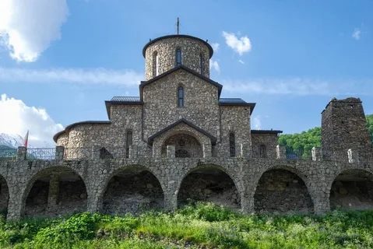
Alan Holy Dormition Monastery
This monastery does not belong to the historical monuments of architecture — its main building was erected in 2000. However, the architectural style is corresponded to the Byzantine canons. Even the materials are selected in such a way that it seems as if this structure was erected several centuries ago, and natural stone was used in the construction process. Two watchtowers of the XVIII century have also been preserved, which became part of the entire ensemble. This monastery is located in the highlands, is an object of pilgrimage and one of the largest spiritual centers of North Ossetia and the entire southern part of Russia. Many tourist routes include a visit to the monastery. Guests here are offered infusions of medicinal herbs, you can take a photo of the exterior.

Slide 14
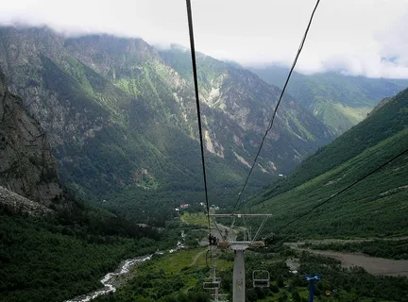
Tsey Gorge
Tsey Gorge is a natural attraction that stretches for 23 kilometers. The height of the gorge is 1300 meters. The gorge attracts an amazing beauty of nature, its fresh air. Comfortable recreation centres and ski resorts are organized here. There is no need to go to the Swiss Alps because the Republic of North Ossetia is an ideal place to meet all your wishes: a well-equipped ski complex in the mountainous region of Tsey. The tourist complex under this name can accommodate 320 guests. Ski routes for beginners amateur and advanced guests are at your service.

Slide 15
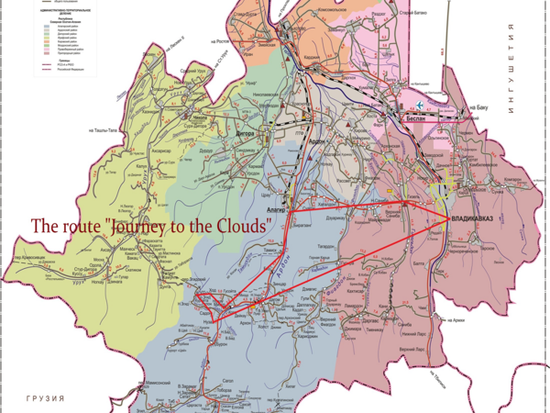

Slide 16
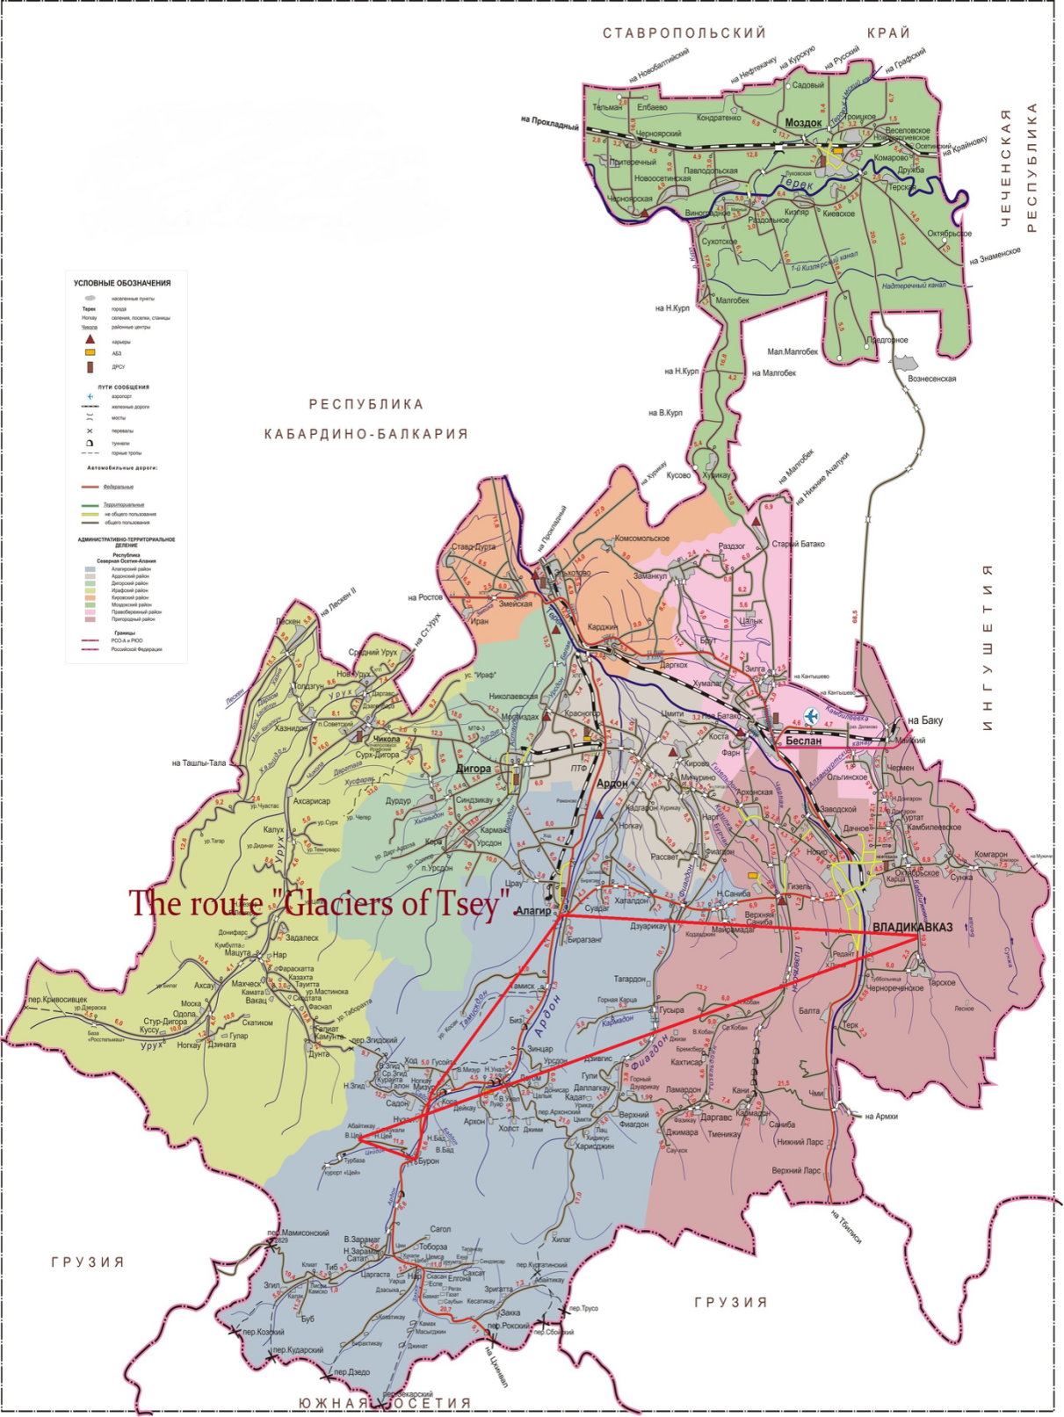

Slide 17
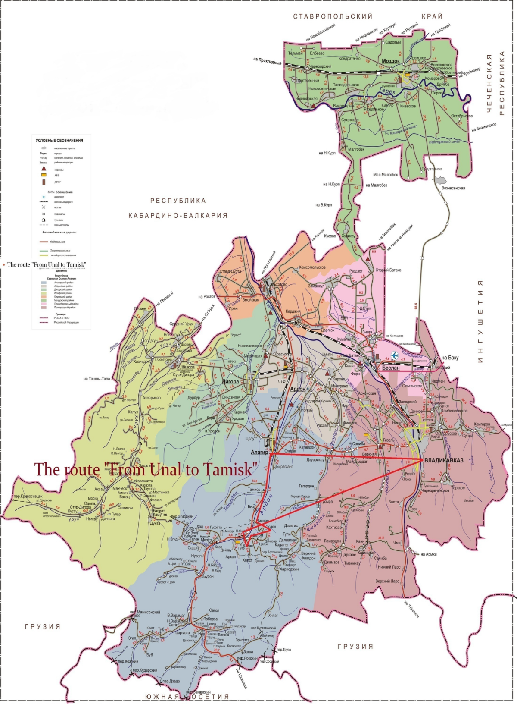

Slide 18

I’d like to complete my tourist route to The Upper Mizur and the village Ksurt. The name of Ksurt was mentioned in the printed book «We are children of nature» written and translated by my English teacher Irene Cheldieva.

Slide 19
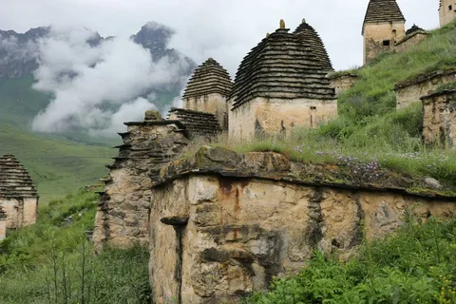
THE CONCLUSION
Previously, in Soviet times, there were many routes in Vladikavkaz. There were camp sites in Vladikavkaz, Alagir, Fiagdon, and Tsey. Everything new is a well-forgotten old. Therefore, you can use the old routes or the new ones I have suggested.
We can talk about this forever, but I will focus on the development of tourism in my area, as this is an opportunity to develop infrastructure, it provides additional jobs for young people, it attracts more and more tourists, increases the cultural level of our nation, and also makes a huge contribution to the development of foreign languages.

